Slide 1
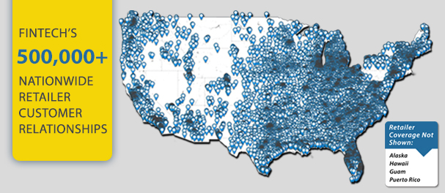

Case background - Who is Fintech?
Pioneer in the legal recognition of electronic payments as a cash equivalent for alcohol
Process payments on time and in compliance with state and federal regulations
Advanced data analytics for clients
Rapidly growing customer base
Notes:
Fintech is a pioneer in the legal recognition of electronic payments as a cash equivalent for alcohol with their Electronic Fund Transfer Payment System (EFTPS)
Whenever a participating wholesaler delivers alcohol to a retailer, a transaction is recorded. Fintech guarantees to process payments…
Fintech’s customer base has grown considerably, leading to more transactions and more data volume
To meet these demands they need a scalable and cost-effective solution for data storage and analytics and that is why they decided to look into cloud computing
Deliver strong analytical solutions for Fintech’s customers and make it easier (for them) to derive valuable insights from their data
Recent significant investments in new technologies and the blend of new firms entering the market meaning making a move to cloud would make Fintech become the technology leadership

Slide 2

Recommendation
AWS is the best choice based on cost-effectiveness, accessibility, and security
AWS offers 12 months free trial with significant products and services such as RDS with SQL and Oracle
Run a test on Fintech’s data before making a final decision to implement new services for the company’s clients

